Slide 1
Packets & Protocols (Part 2)
Exploring HTTP, HTML, and Internet Scalability

Slide 2
Learning Outcomes
Understand the basics of HTTP and HTML.
Learn how scalability helps the Internet handle millions of users.
Explore how protocols like HTTP and HTML facilitate browsing the web.

Slide 3

What is HTTP ?
HTTP (Hypertext Transfer Protocol) is a protocol that allows web browsers and servers to communicate.
How It Works: When you type a website URL in your browser, HTTP helps send a request to the server for the website’s data, and the server responds with the requested information (usually HTML files).
Stateless Protocol: HTTP is stateless, meaning every request is separate, and the server doesn’t remember previous requests.
For example: When you visit a website, HTTP works like a messenger between your browser and the server.

Slide 4
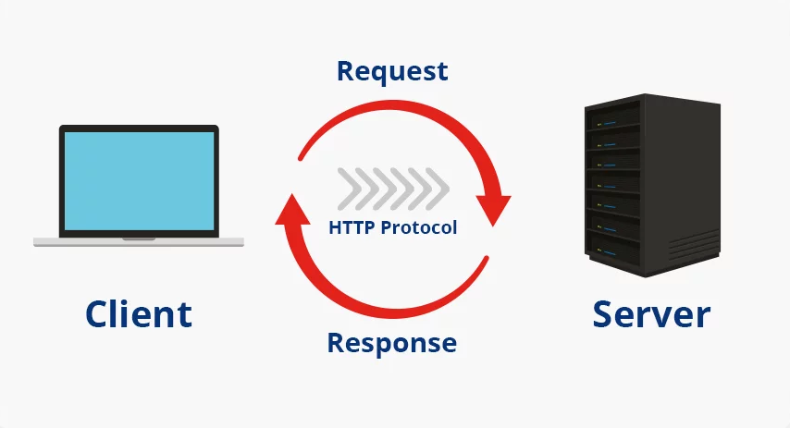
HTTP Requests and Responses
Request: When you click a link or type in a URL, your browser sends an HTTP request to the server. The request asks for specific resources (like a web page or an image).
Response: The server sends an HTTP response back with the requested data, such as HTML files that make up the webpage.
Example: If you request www.example.com, the server will send back the content of that website in its response.

Slide 5

What is HTML ?
Definition: HTML (HyperText Markup Language) is the language used to structure web pages. It tells browsers how to display text, images, and other elements on a page.
Role of HTML: Every time you visit a webpage, the browser uses the HTML code received from the server to show you the page’s layout, text, and images.
Basic Structure:
Tags: HTML uses tags like <h1>, <p>, and <img> to define elements.
Example: <h1> for headings, <p> for paragraphs, and <img> for images.

Slide 6
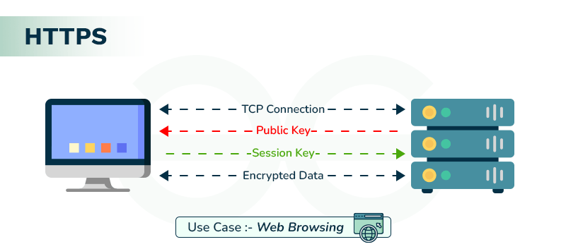
How HTTP and HTML Work Together
Combining HTTP and HTML: When you visit a website, the browser sends an HTTP request to the server, which responds with HTML files that the browser uses to display the webpage.
Example: When you type “www.example.com”, HTTP retrieves the HTML code that makes up the website, and your browser shows you the webpage.

Slide 7
What is Scalability ?
Definition: Scalability means the ability to handle more users, more devices, and more data without slowing down.
Why It Matters: The Internet is designed to grow and adapt to more users without breaking or slowing down.
Handling Millions of Users: Websites and services use scalable technologies to ensure they can serve thousands or even millions of users at the same time.
Example: Imagine a small road that expands to a multi-lane highway as more cars (users) travel on it.

Slide 8
How Does the Internet Scale ?
Load Balancing: Websites use load balancers to distribute incoming traffic evenly across multiple servers, making sure no single server gets overwhelmed.
Caching: Data like images or videos are temporarily stored closer to the user to reduce load on servers and make websites faster.
Cloud Computing: Services like cloud computing make it easier to add more server capacity whenever needed.

Slide 9
How Protocols Help Scalability
Protocols Are Flexible: The protocols we use (like TCP/IP and HTTP) are designed to adapt and scale as more devices connect to the Internet.
Multiple Paths: Data packets can travel across multiple paths, making sure the network isn’t overloaded.
Protocols Keep Data Organized: Even as the Internet grows, protocols ensure that data is sent and received efficiently and accurately.

Slide 10
How HTTP Makes the Web Scalable
Statelessness: Because HTTP doesn’t remember previous requests, each request is treated as new, which helps with scaling.
Caching: HTTP supports caching mechanisms that store copies of websites so they don’t have to be loaded from the server every time.
HTTP/2: The newer version, HTTP/2, can handle multiple requests at once, making websites faster and more scalable.

Slide 11
Key Takeaways
HTTP is the protocol used to request and send data between your browser and a website server.
HTML is the language used to build and structure websites.
Scalability ensures that the Internet can grow and handle millions of users efficiently.
Protocols like HTTP, TCP/IP, and others allow the Internet to stay reliable and efficient even as it expands.

Slide 12
Conclusion
HTTP and HTML are the building blocks of websites and make the web function.
The Internet is designed to scale so that it can serve billions of users without crashing.

